Slide 1
PYTHON : PROGRAMMING LANGUAGE FOR FUTURE!
Premanand S
School of Electronics Engineering (SENSE)
Vellore Institute of Engineering, Chennai campus

Slide 2
3 CONTROL STRUCTURES
Decision making and Branching
If.. If-else.. Nested if.. Multi way if-elif statements
Try and except
Looping: while loop, for loop – else clauses in loops, nested loops
Break, continue and pass statements

Slide 3
IMPORTANCE
Flow control
Decision making
Repetition
Error handling
Modularity
Optimization
User interaction
Algorithm implementation

Slide 4
PYTHON – IF..ELSE..ELIF STATEMENTS

Slide 5
DECISION MAKING
Decision making process
If statement
If…else statement
If… elif…else statement
Nested if statement

Slide 6
Conditional Steps
x = 5
x < 10 ?
Yes
Program:
x = 5
if x < 10:
print('Smaller')
if x > 20:
print('Bigger')
print('Finis')
No
print('Smaller')
Output:
Smaller
Finis
x > 20 ?
Yes
No
print('Bigger')
print('Finis')

Slide 7
Comparison Operators
Boolean expressions ask a question and produce a Yes or No result which we use to control program flow
Boolean expressions using comparison operators evaluate to True / False or Yes / No
Comparison operators look at variables but do not change the variables
Python | Meaning
< | Less than
<= | Less than or Equal to
== | Equal to
>= | Greater than or Equal to
> | Greater than
!= | Not equal
Remember: “=” is used for assignment.
http://en.wikipedia.org/wiki/George_Boole

Slide 8
Comparison Operators
x = 5
if x == 5 :
print('Equals 5')
if x > 4 :
print('Greater than 4')
if x >= 5 :
print('Greater than or Equals 5')
if x < 6 : print('Less than 6')
if x <= 5 :
print('Less than or Equals 5')
if x != 6 :
print('Not equal 6')
Equals 5
Greater than 4
Greater than or Equals 5
Less than 6
Less than or Equals 5
Not equal 6

Slide 9
One-Way Decisions
x = 5
print('Before 5')
if x == 5 :
print('Is 5')
print('Is Still 5')
print('Third 5')
print('Afterwards 5')
print('Before 6')
if x == 6 :
print('Is 6')
print('Is Still 6')
print('Third 6')
print('Afterwards 6')
Yes
x == 5 ?
Before 5
Is 5
Is Still 5
Third 5
Afterwards 5
Before 6
Afterwards 6
No
print('Is 5’)
print('Still 5')
print('Third 5')

Slide 10
increase / maintain after if or for
decrease to indicate end of block
x = 5
if x > 2 :
print('Bigger than 2')
print('Still bigger')
print('Done with 2')
for i in range(5) :
print(i)
if i > 2 :
print('Bigger than 2')
print('Done with i', i)
print('All Done')

Slide 11
Think About begin/end Blocks
x = 5
if x > 2 :
print('Bigger than 2')
print('Still bigger')
print('Done with 2')
for i in range(5) :
print(i)
if i > 2 :
print('Bigger than 2')
print('Done with i', i)
print('All Done')

Slide 12
Nested Decisions
x > 1
yes
no
print('More than one’)
x = 42
if x > 1 :
print('More than one')
if x < 100 :
print('Less than 100')
print('All done')
x < 100
yes
no
print('Less than 100')
print('All Done')

Slide 13
Two-Way Decisions
x = 4
Sometimes we want to do one thing if a logical expression is true and something else if the expression is false
It is like a fork in the road - we must choose one or the other path but not both
no
x > 2
yes
print('Not bigger')
print('Bigger')
print('All Done')

Slide 14
Two-Way Decisions with else:
x = 4
no
x > 2
yes
x = 4
if x > 2 :
print('Bigger')
else :
print('Smaller')
print('All done')
print('Not bigger')
print('Bigger')
print('All Done')

Slide 15
Visualize Blocks
x = 4
no
x > 2
yes
x = 4
if x > 2 :
print('Bigger')
else :
print('Smaller')
print('All done')
print('Not bigger')
print('Bigger')
print('All Done')

Slide 16
Multi-way
yes
x < 2
print('small')
if x < 2 :
print('small')
elif x < 10 :
print('Medium')
else :
print('LARGE')
print('All done')
no
yes
x < 10
print('Medium')
no
print('LARGE')
print('All Done')

Slide 17
Multi-way
x = 0
yes
x < 2
print('small')
x = 0
if x < 2 :
print('small')
elif x < 10 :
print('Medium')
else :
print('LARGE')
print('All done')
no
yes
x < 10
print('Medium')
no
print('LARGE')
print('All Done')

Slide 18
Multi-way
x = 5
yes
x < 2
print('small')
x = 5
if x < 2 :
print('small')
elif x < 10 :
print('Medium')
else :
print('LARGE')
print('All done')
no
yes
x < 10
print('Medium')
no
print('LARGE')
print('All Done')

Slide 19
Multi-way
x = 20
yes
x < 2
print('small')
x = 20
if x < 2 :
print('small')
elif x < 10 :
print('Medium')
else :
print('LARGE')
print('All done')
no
yes
x < 10
print('Medium')
no
print('LARGE')
print('All Done')

Slide 20
IF STATEMENT
If expression:
statement (s)
Expression true – statement will proceed
Expression false – statement will not proceed

Slide 21
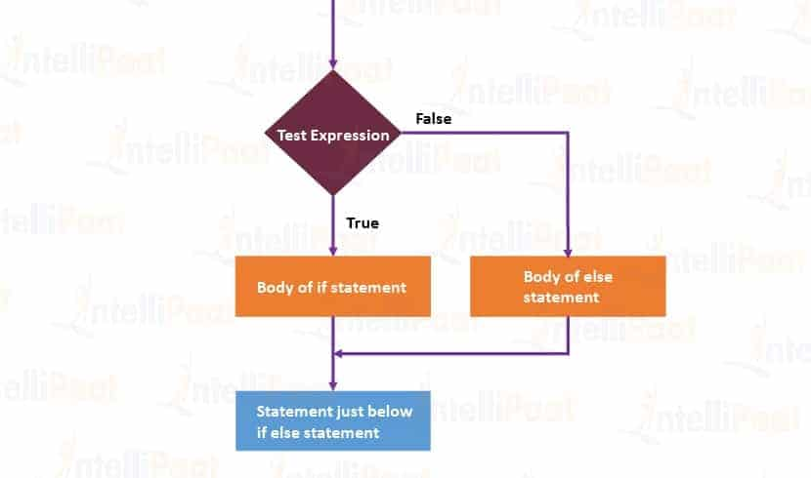
FLOW CHART –
IF STATEMENT

Slide 22
IF ELSE STATEMENT
if test expression:
Body of if
else:
Body of else
Expression true – body of if
Expression false – body of else

Slide 23
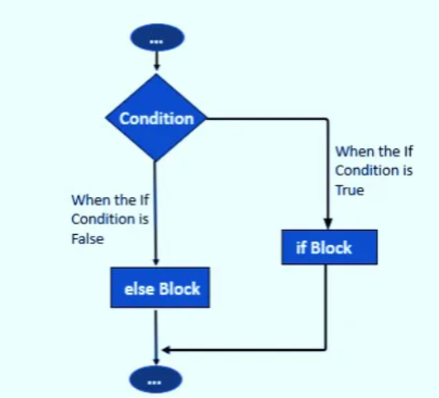
IF ELSE – FLOW CHART

Slide 24
IF … ELIF … ELSE STATEMENT
if test expression:
Body of if
elif test expression:
Body of elif
else:
Body of else
Elif – else if condition
If – false – will check elif
All condition is false – body else will execute
If .. Elif … else (any one will execute)
The if block can have only one else block. But it can have multiple elif blocks

Slide 25
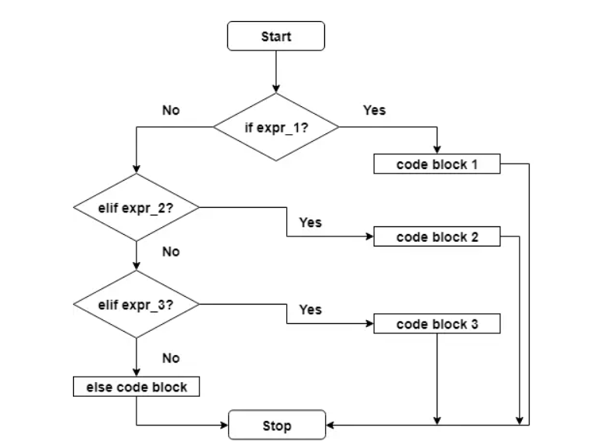
IF… ELSE… ELIF – FLOW CHART

Slide 26
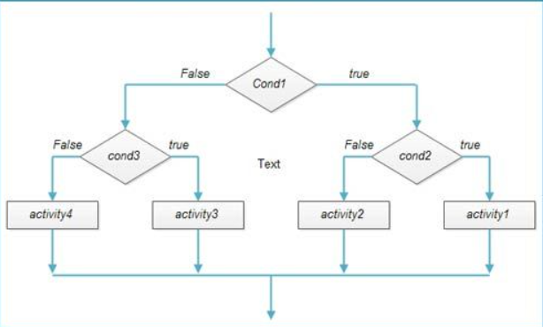
NESTED IF STATEMENT
We can have a if...elif...else statement inside another if...elif...else statement
Indentation is the only way to figure out the level of nesting.

Slide 27
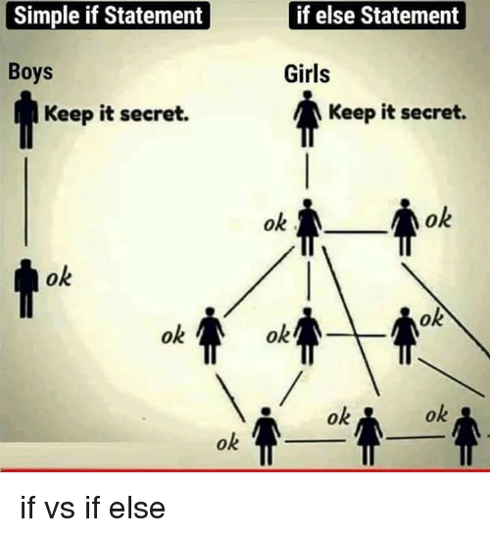
IF STATEMENT – MEME EXPLANATION

Slide 28
The try / except Structure
You surround a dangerous section of code with try and except
If the code in the try works - the except is skipped
If the code in the try fails - it jumps to the except section

Slide 29
$ python3 notry.py
Traceback (most recent call last): File "notry.py", line 2, in <module> istr = int(astr)ValueError: invalid literal for int() with base 10: 'Hello Bob'
$ cat notry.py
astr = 'Hello Bob'
istr = int(astr)
print('First', istr)
astr = '123'
istr = int(astr)
print('Second', istr)
All
Done

Slide 30
$ python3 notry.py
Traceback (most recent call last): File "notry.py", line 2, in <module> istr = int(astr)ValueError: invalid literal for int() with base 10: 'Hello Bob'
The program stops here
$ cat notry.py
astr = 'Hello Bob'
istr = int(astr)
print('First', istr)
astr = '123'
istr = int(astr)
print('Second', istr)
All
Done

Slide 31
astr = 'Hello Bob'
try:
istr = int(astr)
except:
istr = -1
print('First', istr)
astr = '123'
try:
istr = int(astr)
except:
istr = -1
print('Second', istr)
When the first conversion fails - it just drops into the except: clause and the program continues.
$ python tryexcept.py
First -1
Second 123
When the second conversion succeeds - it just skips the except: clause and the program continues.

Slide 32
try / except
astr = 'Bob'
print('Hello')
astr = 'Bob'
try:
print('Hello')
istr = int(astr)
print('There')
except:
istr = -1
print('Done', istr)
istr = int(astr)
print('There')
istr = -1
print('Done', istr)
Safety net

Slide 33
Sample try / except
rawstr = input('Enter a number:')
try:
ival = int(rawstr)
except:
ival = -1
if ival > 0 :
print('Nice work')
else:
print('Not a number')
$ python3 trynum.py
Enter a number:42
Nice work
$ python3 trynum.py
Enter a number:forty-two
Not a number
$

Slide 34
ASSIGNMENT
Write a Python program that takes an integer as input and prints "Even" if it's an even number and "Odd" if it's an odd number.
Create a program that checks whether a given year is a leap year or not. A leap year is divisible by 4, except for years that are divisible by 100 but not by 400.
Write a program that prompts the user to enter their age and then tells them whether they are a child (0-12), teenager (13-19), adult (20-64), or senior (65+).
Write a program that calculates the cost of a movie ticket based on the age of the viewer. Tickets for children (age <= 12) cost $5, tickets for adults (age 13-64) cost $10, and tickets for seniors (age >= 65) cost $7.

Slide 35
ASSIGNMENT
Create a program that takes a user's exam score as input (out of 100) and prints their grade according to the following scale:
90-100: A
80-89: B
70-79: C
60-69: D
Below 60: F
Create a program that asks the user for the lengths of three sides of a triangle and determines whether the triangle is equilateral (all sides are equal), isosceles (two sides are equal), or scalene (no sides are equal).

Slide 36
ASSIGNMENT
Write a Python program that prompts the user to enter a month (as a number) and a year. Then, determine and display the number of days in that month. Consider leap years when February has 29 days.
Write a program that takes a user's age and whether they have a driver's license as input. If the user is 18 or older and has a driver's license, print "You can drive." Otherwise, print "You cannot drive."
Write a program that takes three numbers as input and finds the largest among them using conditional statements.

Slide 37
ASSIGNMENT
Create a program that asks the user to enter their age. However, anticipate that the user might enter their age as a non-numeric value (e.g., text). Use a try and except block to handle this potential error. If the user enters a non-numeric value, inform them of the error. If the user enters a numeric value, determine and print whether they are a child (0-12 years), a teenager (13-19 years), an adult (20-64 years), or a senior (65 years and older) based on their age using conditional statements.
Write a program that takes a number as input and calculates the square root of the number. Use a try-except block to handle cases where the input is negative or not a number, and display an appropriate error message.
Create a program that takes the user's age as input and calculates the square of their age. Use a try-except block to catch any input errors, such as non-numeric input, and inform the user about the error.

Slide 38
ASSIGNMENT
Write a program that prompts the user to enter a temperature in Celsius and converts it to Fahrenheit. Use a try-except block to handle cases where the input is not a valid number.
Build a program that takes a string input from the user and attempts to convert it to an integer. Handle any ValueError exceptions that might occur and print an error message when non-numeric input is provided.
Create a program that asks the user for their birth year and calculates their age. Use a try-except block to handle cases where the input is not a valid year or cannot be converted to an integer.
Write a program that reads a file path from the user and tries to open and read the contents of the file. Handle the FileNotFoundError using a try-except block and display a message indicating that the file could not be found.

Slide 39
ASSIGNMENT
Build a program that calculates the area of a rectangle. Ask the user for the length and width of the rectangle, and use a try-except block to handle cases where the input is not a valid number.
Create a program that takes a numerical grade as input and converts it to a letter grade (A, B, C, D, F). Use a try-except block to catch any input errors and display an error message if the input is not within the valid range.

Slide 40
HAPPY LEARNING & HAPPY CODING!
WhatsApp +91 7358679961
Official: premanand.s@vit.ac.in
Personal: er.anandprem@gmail.com
Weblink: www.anandsdata.com
Github: https://github.com/anandprems
Linkedin: https://www.linkedin.com/in/premsanand/
Author @ Analytics Vidya: https://www.analyticsvidhya.com/blog/author/premanand17/

